Slide 1


Unequal Pay, Unequal Power: Gender and Workplace Disparities in India
By
Mayukh Paul Registration No – 220010026832
Enrolment No – 2211212001006
Semester/Year: 6th/3rd
Sister Nivedita University
Kol - 700156

Slide 2


TABLE OF CONTENTS
01
INTRODUCTION
02
Literature Review
03
METHODOLOGY
04
CONCLUSION
With Problem Statement
With Recommendation
With Inquiry

Slide 3

01
INTRODUCTION

Slide 4
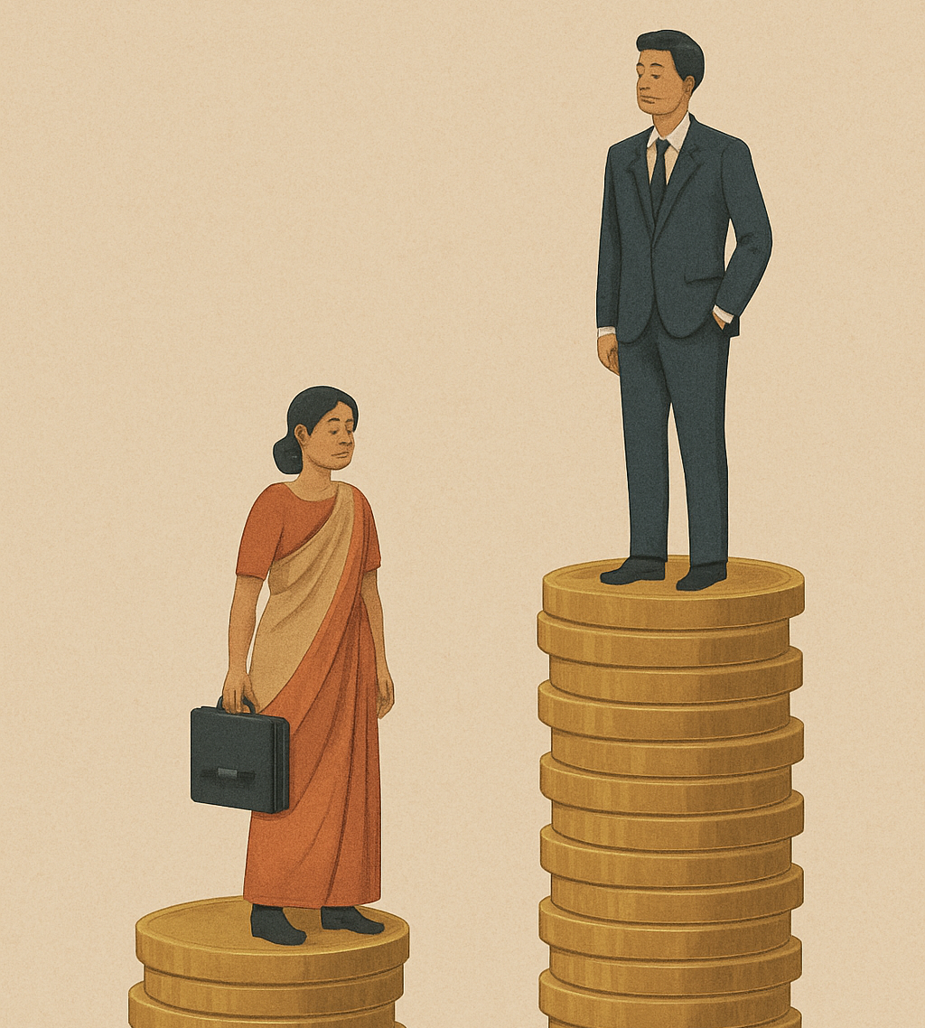
INTRODUCTION
This study looks at the wage differences between men and women in India and tries to understand why they still exist. Even though we have laws for equal pay, women continue to earn less than men in most sectors. The reasons go beyond just economics — they include cultural norms, biased hiring, fewer promotions, and limited leadership roles for women. The problem is worse in rural areas and in informal jobs, where women can earn up to 22% less than urban male workers. These wage gaps show not only inequality in pay but also deeper issues in our society that affect women’s chances at fair and equal work.

Slide 5

PROBLEMATIC STATEMENT
Women are often paid less than men for the same work, due to factors like
Cultural beliefs
Limited promotions
Biased hiring
These gaps are not just economic but reflect deeper social inequalities. This study looks at how gender and job sectors influence wage differences and aims to provide insights for fairer and more inclusive policies.

Slide 6

02
LITERATURE REVIEW

Slide 7

AN OVERVIEW
Rustagi (2009): Sociocultural roots of wage disparity.
Taneja & Batra (2023): 20–30% wage gap persists despite similar education.
Kumar (2023): Education, occupation bias, and direct wage differences matter.
Kanica Chopra (2021): gender-based wage disparities and inequality

Slide 8
03
DATA & METHODOLOGY

Slide 9
RESEARCH OVERVIEW
DATA SOURCE
ANALYTICAL TOOL
METHOD APPROACH
HYPOTESIS TESTING
National Family Health Survey (NFHS-5)
STATA
Linear Regression Model Logistic Regression Model
Null Hypothesis
Alternative Hypothesis
Analyse how socio-demographic variables influence labour force participation

Slide 10
1.1 Linear Regression
ANALYSIS AND FINDING
Age (mv012) – Individual get older, their labor force increase
Education (mv133) – Coeff is negative showing higher education with lower participations.
Urban Residence (v025) – Indicate City Residents have better employment opportunities
State of Residence (v101) – Showing states culture affect
Cons - It’s mainly a mathematical component used to position the regression line correctly within the model.

Slide 11
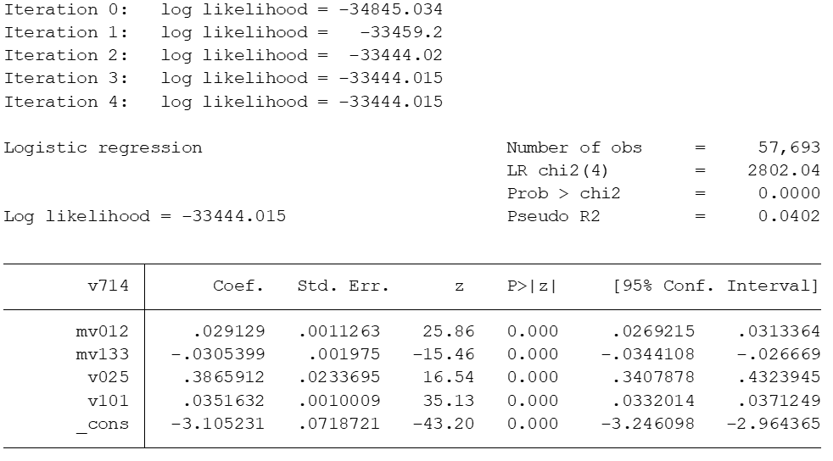
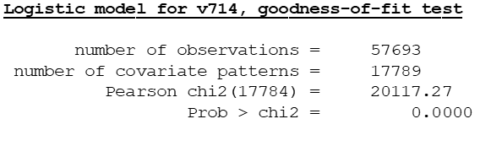
1.2 Logistic Regression
ANALYSIS AND FINDING
Pearson goodness of fit the data well because
p-value is less 0.05
All four variable significantly impact LFP at 1% level

Slide 12

RECOMMENDATION
Increase Employment for Educated Individuals, Especially Women
Reduce Urban–Rural Disparity in Employment
Encourage Employment Across Age Cohorts
State-Specific Employment Strategies
Enhance Research & Data Collection

Slide 13

04
CONCLUSION

Slide 14
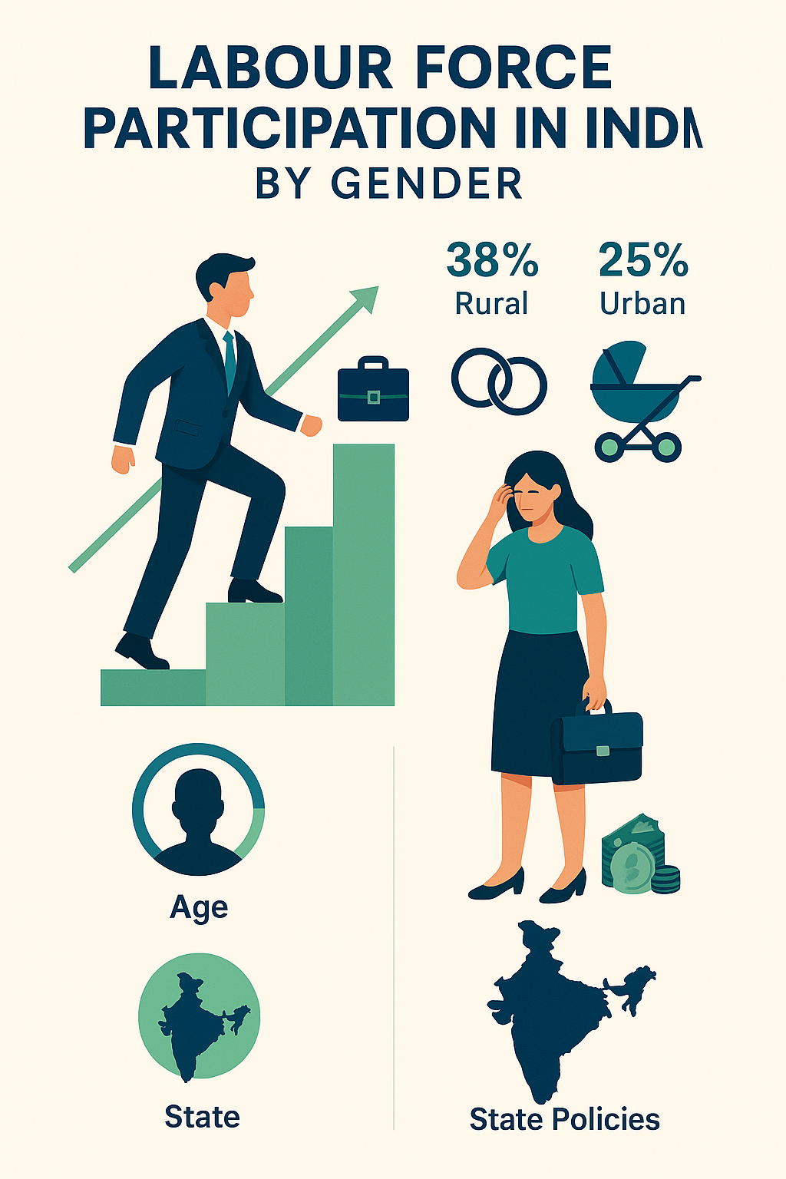
CONCLUSION
Education positively influences labor participation, but gender gaps remain even at higher education levels.
Socio-cultural norms and household responsibilities limit women’s employment, particularly after marriage or childbirth.
Rural-urban divide and state-wise differences highlight unequal access to opportunities and infrastructure.
Policy recommendations: Promote female education, flexible work, childcare support, rural job creation, and state-specific employment strategies.
Inclusive employment policies are essential to ensure economic empowerment and gender equity in the Indian workforce.

Slide 15
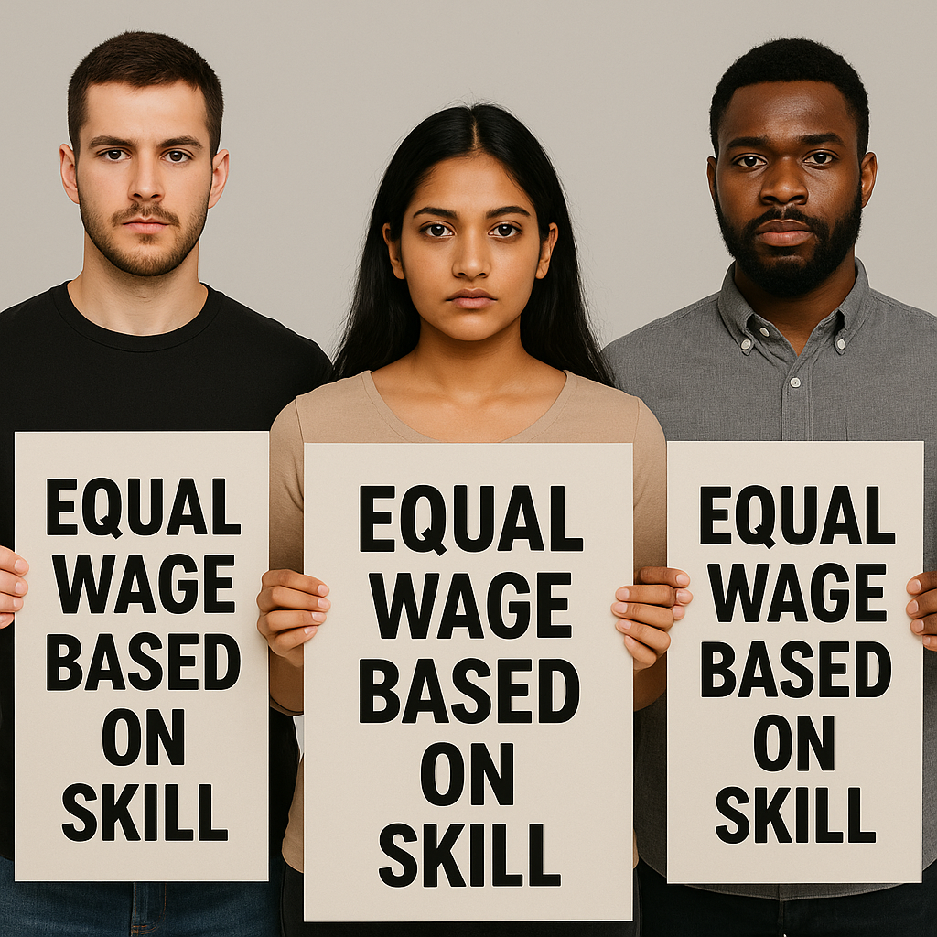
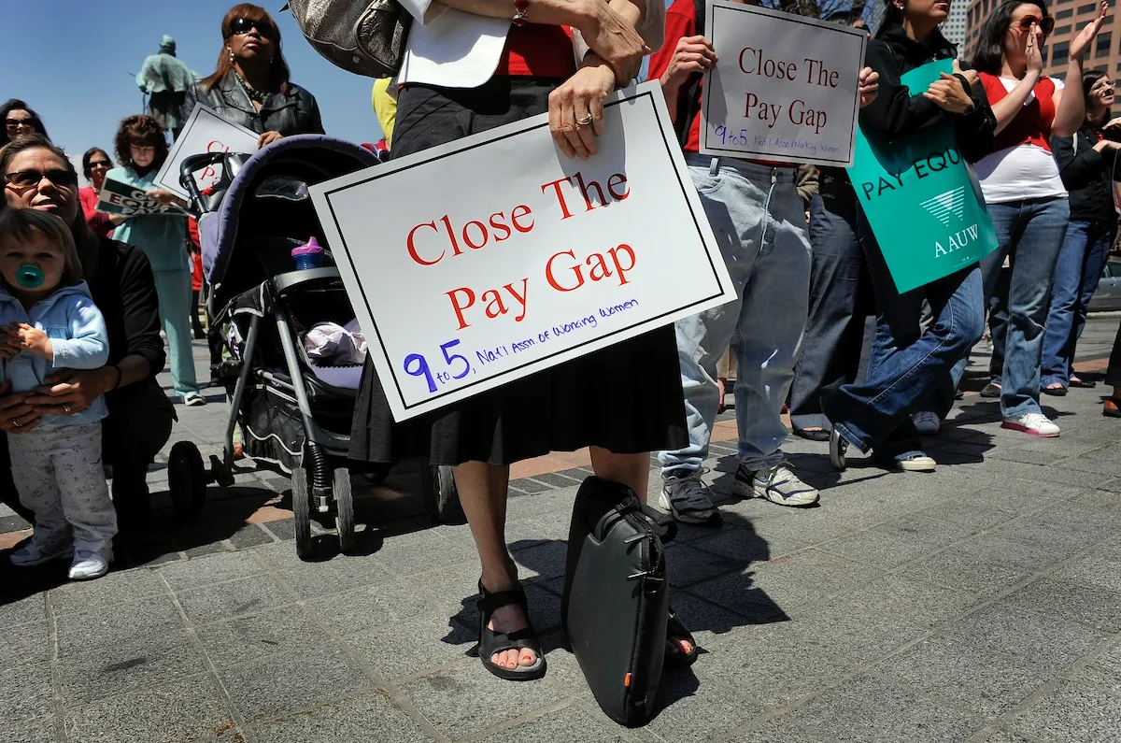
AREAS FOR INQUIRY
Using Longitudinal and Panel Data
Incorporating Wage and Sectoral Data
Intersectionality
Qualitative Research
Government Program Evaluation

Slide 16

"Gender wage equality is not merely about fairness; it is foundational to economic justice and social progress."
—Dr. Claudia Goldin, Nobel Laureate in Economics

Slide 17

THANKS

